Slide 1
Litter in the sea

Slide 2
Plastic as marine litter
Marine litter consists of different materials and is found in sizes from over a meter to less than a micron.
It is found not only on the beaches and on the shoreline, but also floating on the sea surface or in the water column. Most items eventually sink to the seafloor because they lack buoyancy or are transported by natural processes.
Between 60 and 90% of beach litter consists of plastic items.
Most surveys of floating litter and litter on the sea bottom indicate that 80-90% of all items are from artificial polymers.

Slide 3
How plastics reach the sea?
The majority of plastics come from mismanaged waste or from eroded materials washing off land.
Main paths are:
rivers and watercourses
wastewater discharges
direct discharge at the coastline or during sea-based activities

Slide 4
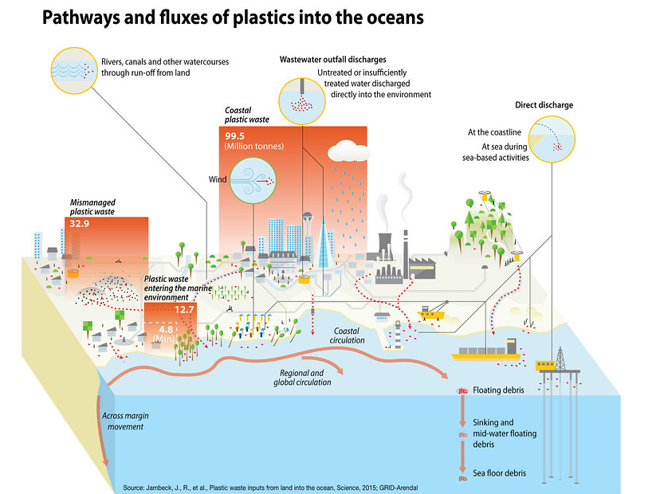

Slide 5
Municipal solid waste and wastewater
The efficiency of solid waste collection and treatment is linked to the amount of marine litter.
Wastewater plants may be a source of microplastics, if they are not equipped to filter out small particles.

Slide 6
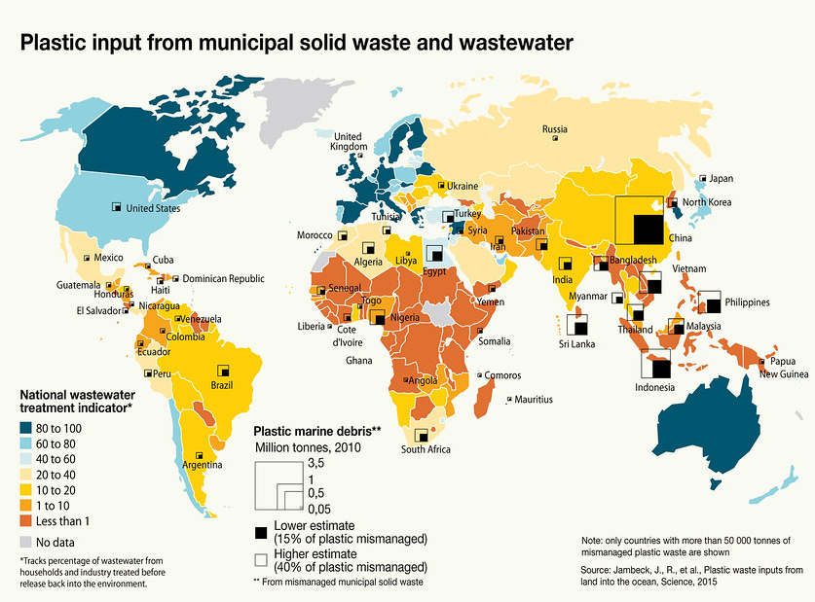

Slide 7
Which plastics float and which sink in seawater?
Plastics are a range of polymer materials, each with different density.
Depending on the density of the particular polymer, plastic items will:
float on the surface
float in the water column, or
sink to the seafloor

Slide 8
Seawater density
Seawater density depends on temperature salinity and pressure. Pressure is determined by depth.
There is a difference in seawater density between the Black Sea and the world ocean due to salinity.
 | World ocean | Black Sea
Salinity, ‰ | 35 | 17-18
Density at the surface, g/cm³ | 1.0281 | 1.0115
Density at depth 1000 m, g/cm³ | 1.0329 | 1.0173

Slide 9
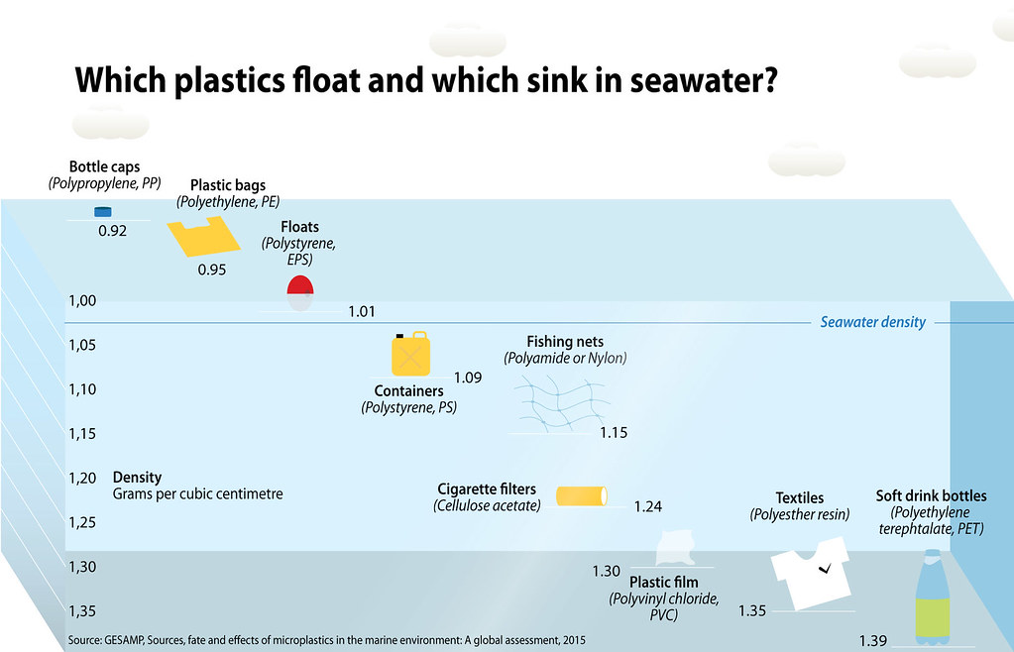

Slide 10








Polymer densities
Symbol | Polymer name | Application | Density, g/cm³
 | Polyethylene terephthalate (PET) | Polyester fibers, soft drink bottles, food containers, microfiber towels | 1.38
 | High-density polyethylene (HDPE or PEHD) | Plastic bags, bottle caps, rubbish bins, oil cans, plastic lumber, toolboxes | 0.94
 | Polyvinyl chloride (PVC) | Window frames, plumbing pipes, flooring, bottles for chemicals | 1.30-1.45
 | Low-density polyethylene (PE) | Plastic bags, buckets, cutting boards, squeeze bottles (for ketchup, mayonnaise, etc.) | 0.917-930
 | Polypropylene (PP) | Flower pots, bumpers, industrial fibers, ropes, food containers for microwave oven, DVD cases | 0.895-0.92
 | Polystyrene (PS) | Toys, beverage/food containers (e.g. yoghurt); EPS, XPS: food containers, packaging, building insulation | 0.96-1.05 0.016-0.64
 | Other plastics: nylon, acrylic, polycarbonate, polylactic acid | Various applications in consumer goods and industry | 1.15 1.18 1.20-1.22 1.21-1.43
 | Acrylonitrile butadiene styrene (ABS) | Computer plastic, TV cases, phones, coffee machines, car parts, Lego bricks | 1.06-1.08

Slide 11
Distribution of plastics by natural processes
Marine litter is transported by winds, waves and currents.
Plastic pieces are broken to smaller fragments by waves and sunlight.
Biological process also add to their dispersion:
  Accumulation of water organisms on the surface of floating litter
  Ingestion
  Burrowing of animals living on the sea bottom

Slide 12
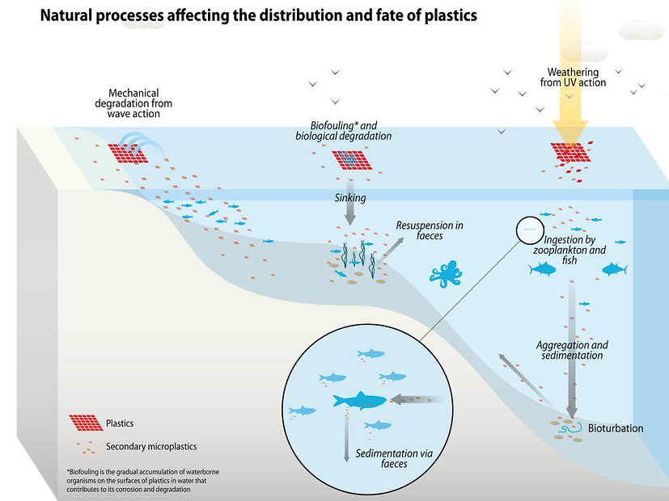

Slide 13
How much plastics are in the oceans?
Between 86 and 150 million tonnes of plastics are estimated to be in the marine environment.
Distribution of all plastics in the sea:
Floating on the surface: less than 1%
Floating in the water column: ⅔
Accumulating on the seafloor: ⅓

Slide 14
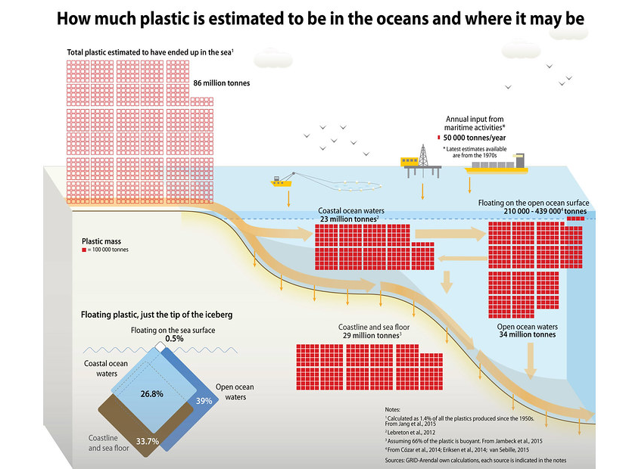

Slide 15
Limiting the impact of marine litter
Cleaning up marine litter from the sea is a complex and costly task.
Prevention is a better option. It can include:
  Awareness raising
  Research and innovation
  Policy implementation
  Economic incentives
  Investment in waste management and wastewater treatment infrastructure

Slide 16
Credits
All figures in this presentation are produced by Maphoto/Riccardo Pravettoni, 2016 & 2018 and are part of the collection Marine Litter Vital Graphics of GRID-Arendal, available at: https://www.grida.no/resources/6933
The images are licenced under CC BY-NC-SA 2.0.

Slide 17
Joint Operational Programme Black Sea Basin 2014–2020
The publication is edited by the Black Sea NGO Network
Varna, November 2020
Joint Operational Programme Black Sea Basin 2014–2020 is co-financed by the European Union through the European Neighbourhood Instrument and by the participating countries: Armenia, Bulgaria, Georgia, Greece, Republic of Moldova, Romania, Turkey and Ukraine
This publication has been produced with the financial assistance of the European Union. The contents of this publication are the sole responsibility of the Black Sea NGO Network and can in no way be taken to reflect the views of the European Union

